Slide 1


A PRESENTATION ON
NVIDIA GPU
RTX 3090
Chaugale Mahadev K.

Slide 2
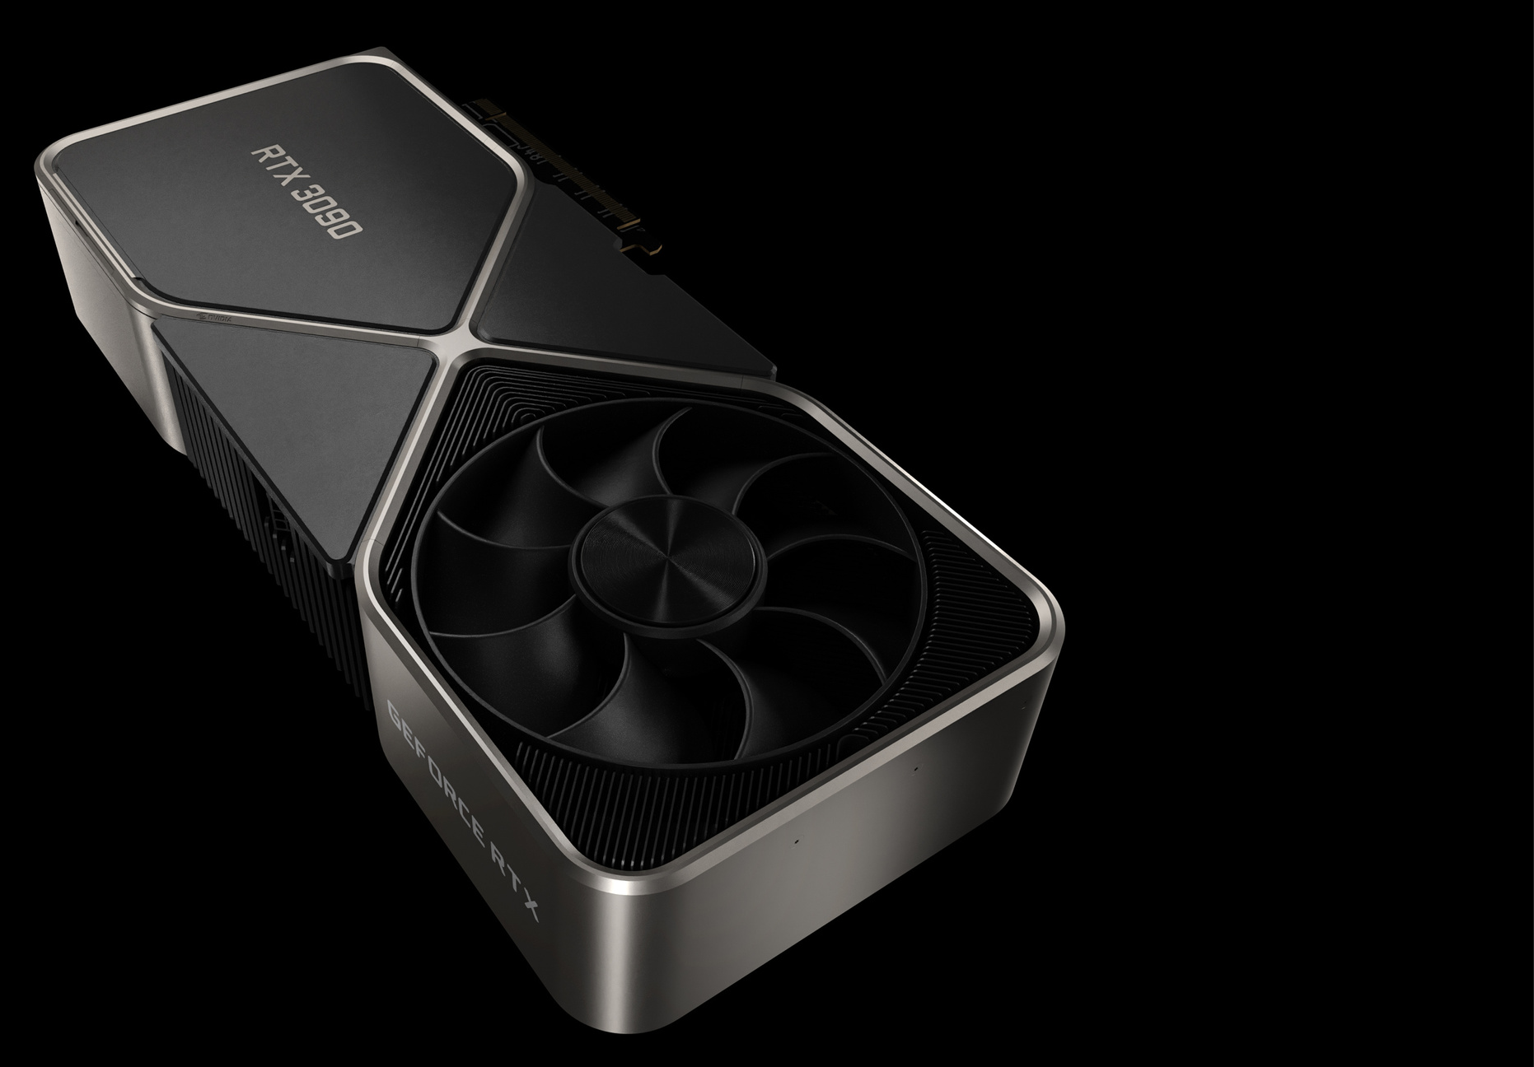
INTRODUCTION
THE BFGPU
The GeForce RTX 3090
is an enthusiast-class graphics card by NVIDIA, launched in September 2020.
Built on the 8 nm process, and based on the GA102 graphics processor.

Slide 3
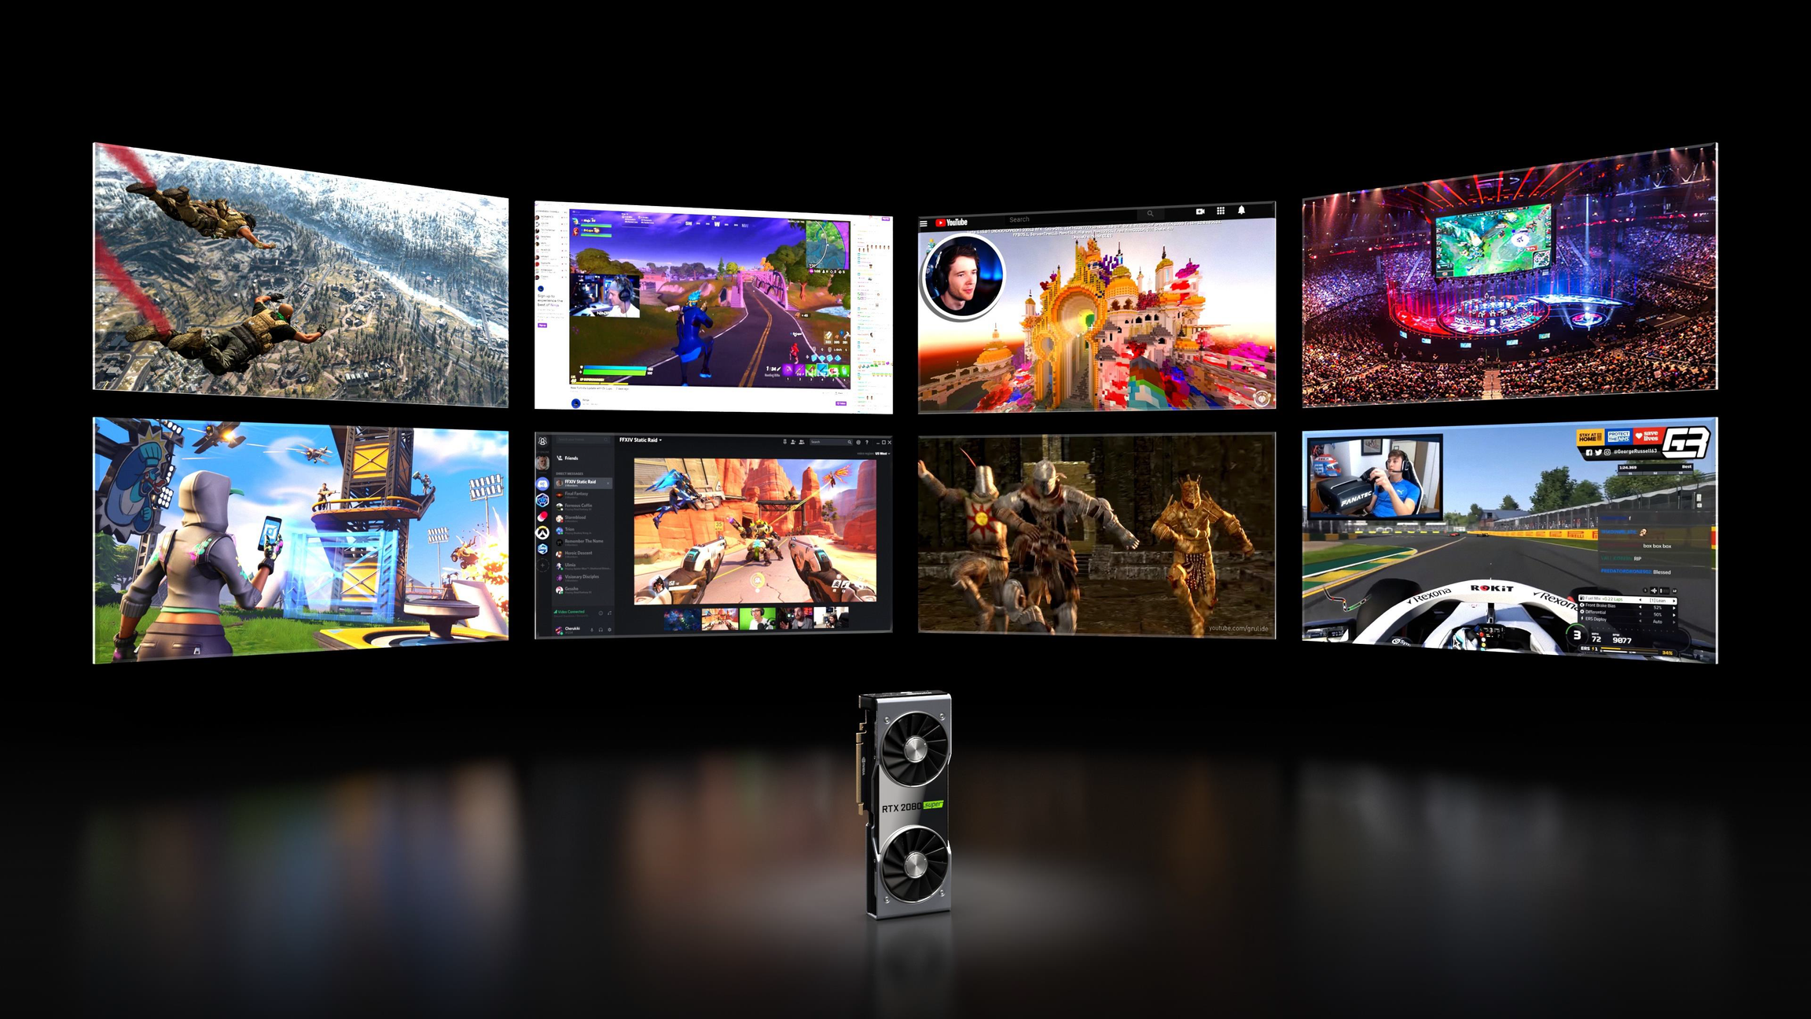
GEFORCE PC GAMING - AN INFINITE PLAYGROUND
GAMING
1.5PC Gamers
LIVE Streaming
20M Live
Streamers
CONTENT CREATORS
45M CREATORS
E-Sports
500M Global Audience

Slide 4
The term "GPU" was coined by Sony in reference to the 32-bit Sony GPU (designed by Toshiba) in the PlayStation video game console, released in 1994. The Nvidia GeForce 256 (also known as NV10) was the first consumer-level card released on the market with hardware-accelerated T&L.
A Graphics Processing Unit (GPU) is a microprocessor that has been designed specifically for the processing of 3D graphics. The processor is built with integrated transform, lighting, triangle setup/clipping, and rendering engines, capable of handling millions of math-intensive processes per second. GPUs allow products such as desktop PCs, portable computers, and game consoles to process real-time 3D graphics that only a few years ago were only available on high-end workstations.
WHAT IS
A GPU?
A BRIEF HISTORY

Slide 5
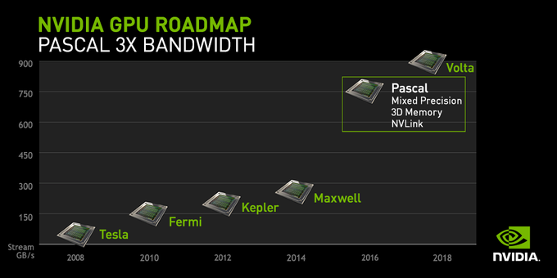

Slide 6
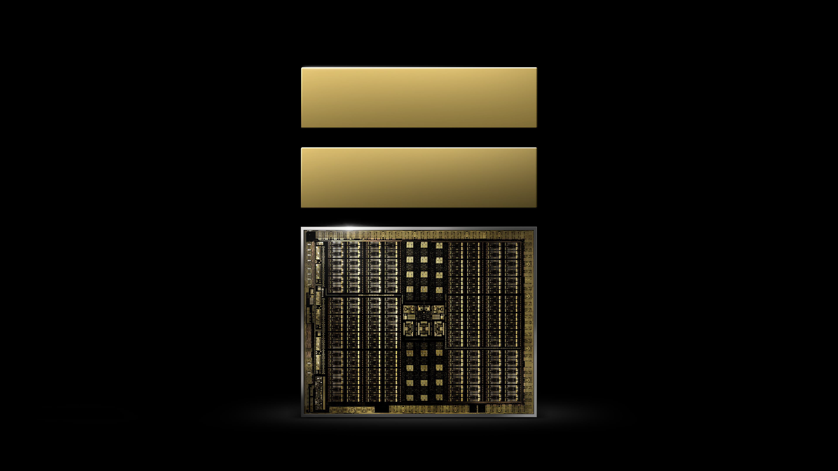
THE
PRESENT
Algorithms
Engine Tech
NVIDIA RTX

Slide 7
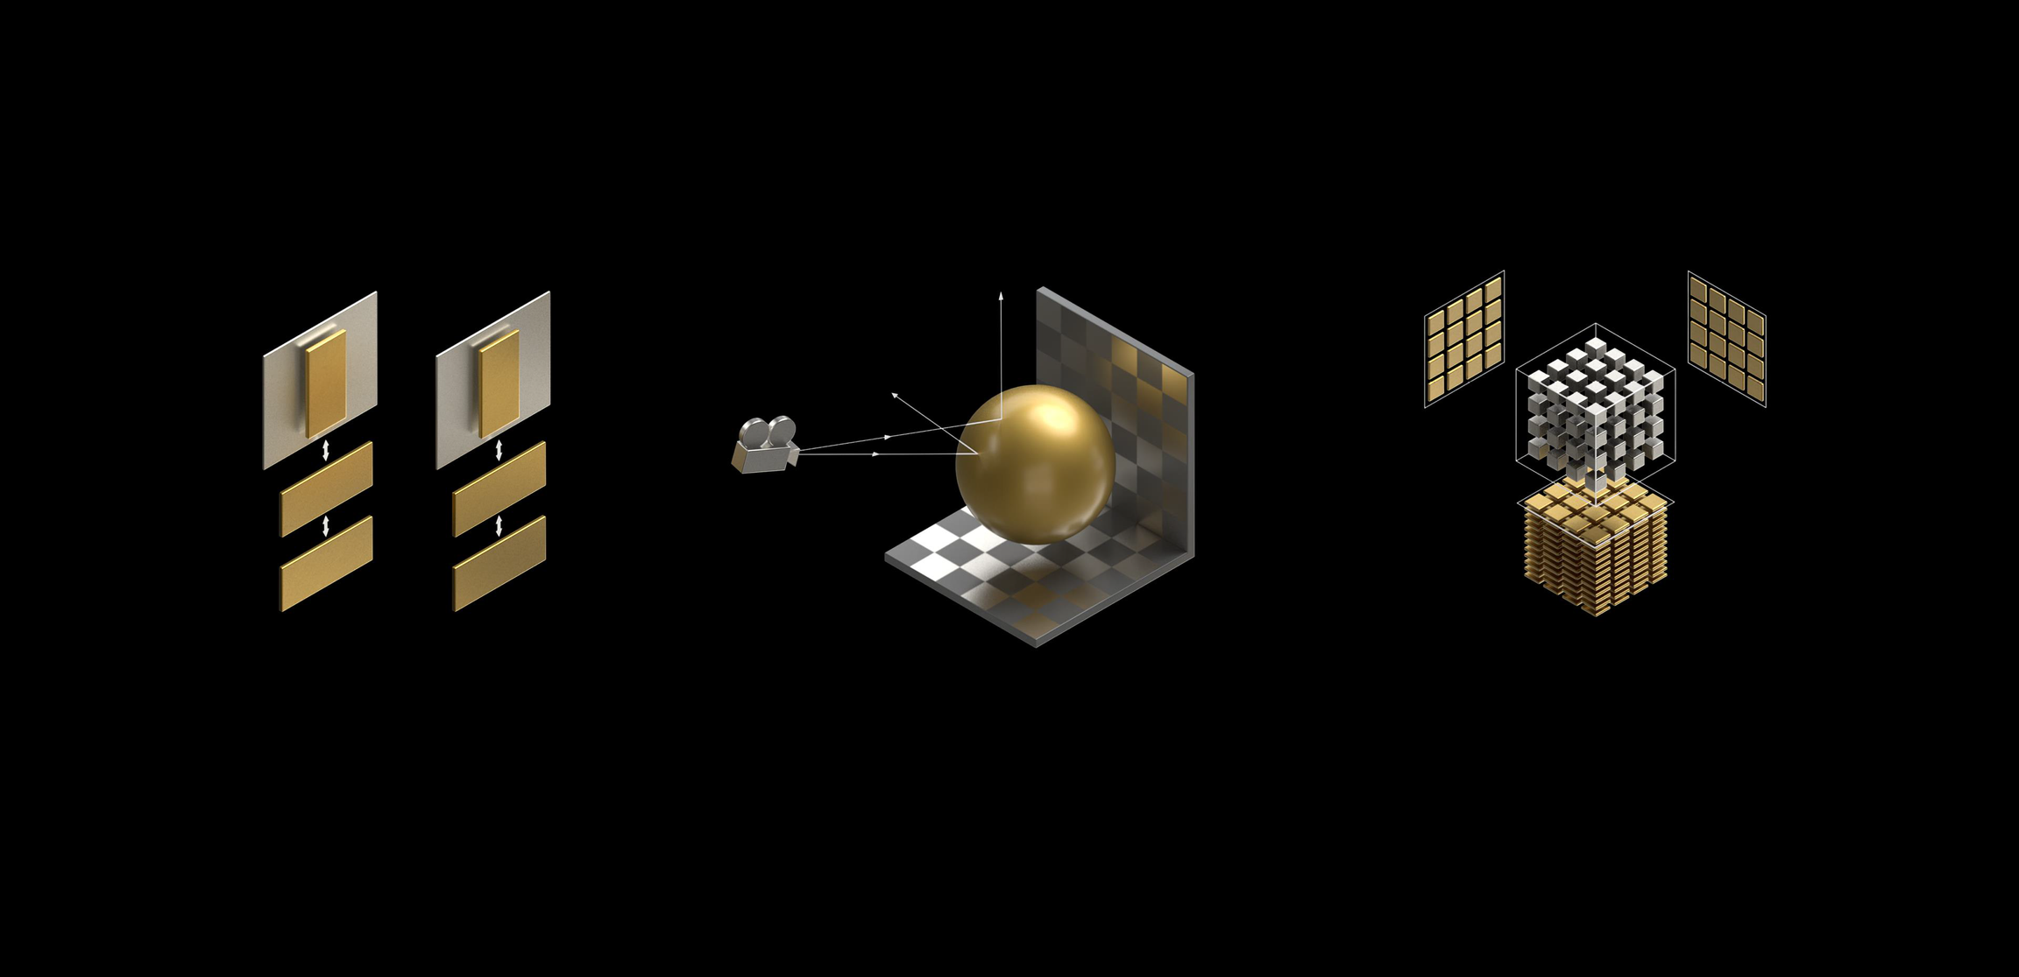
NVIDIA RTX
Programmable Shading
Ray Tracing
A.I.

Slide 8
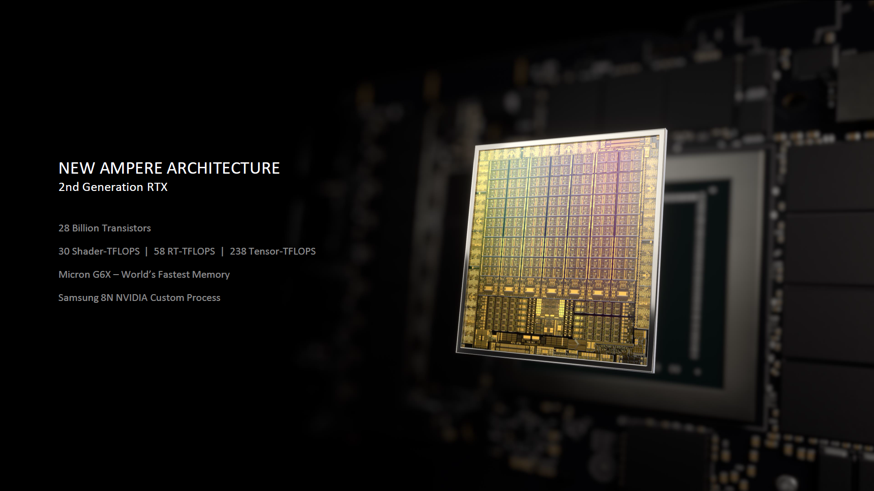

Slide 9
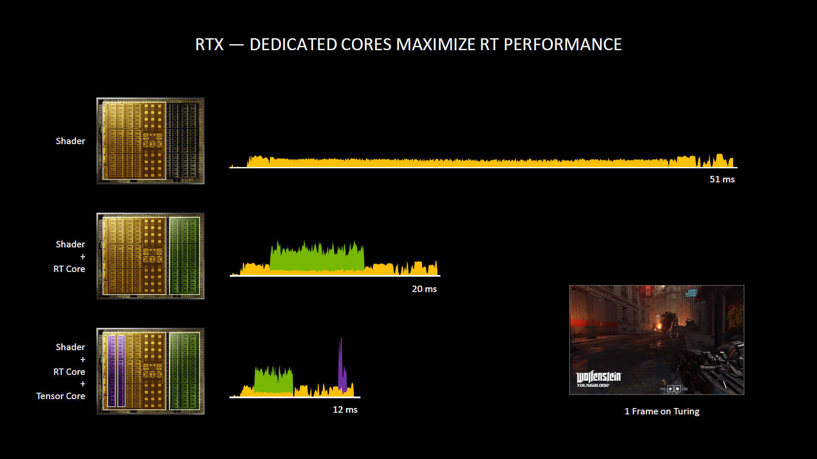

Slide 10
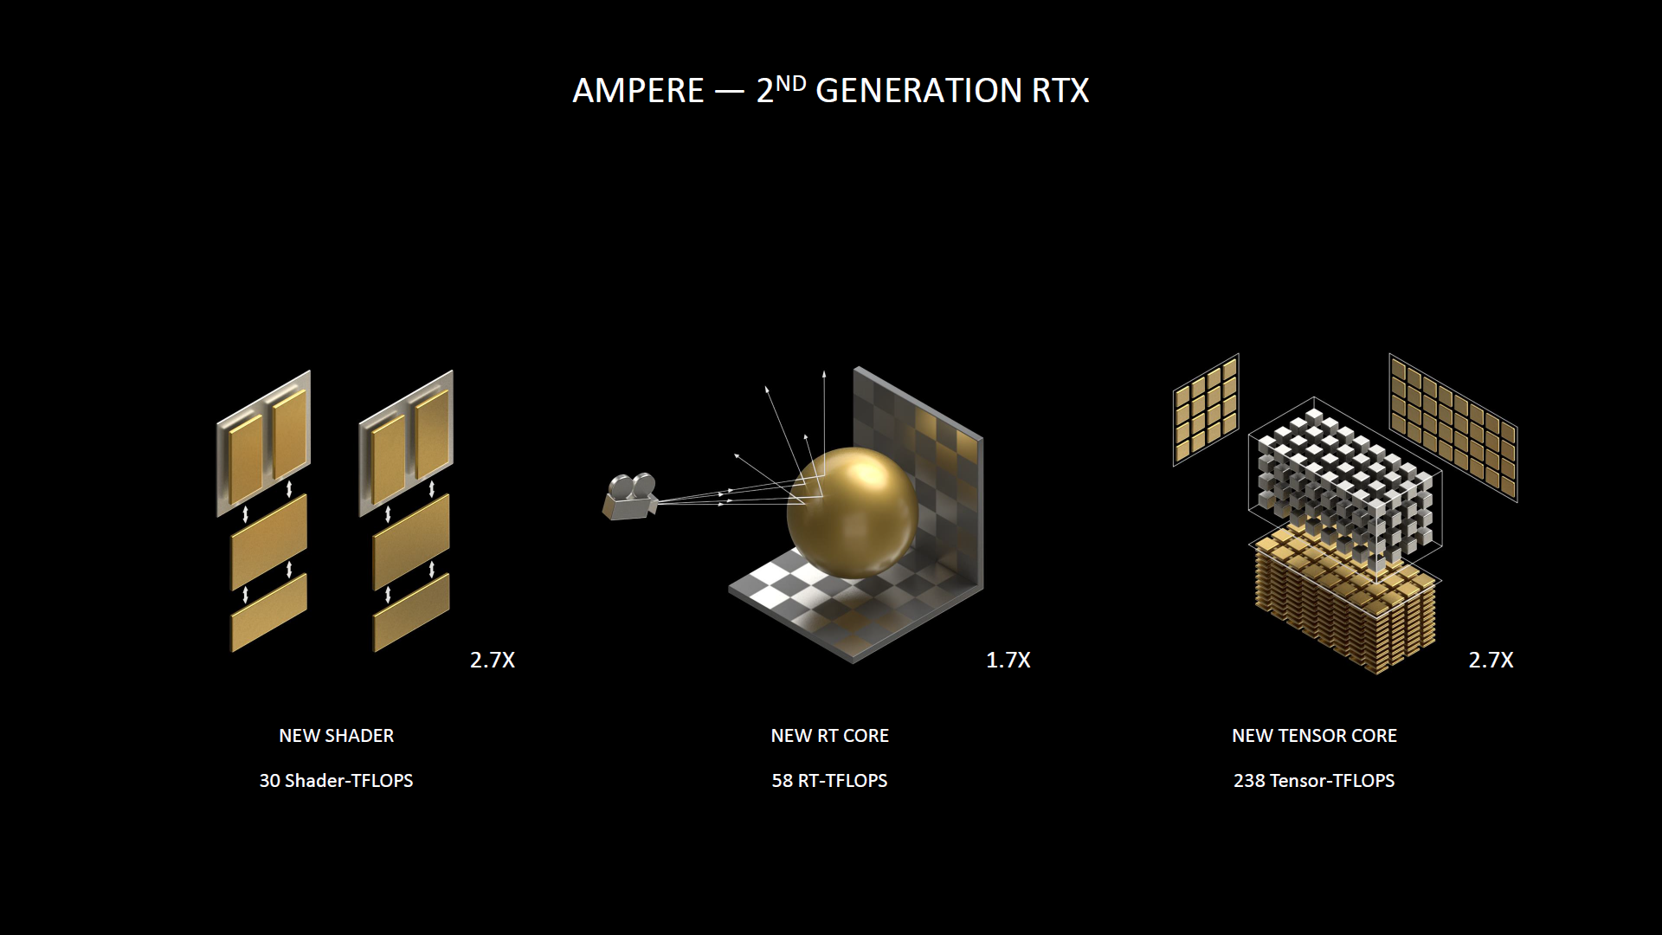

Slide 11
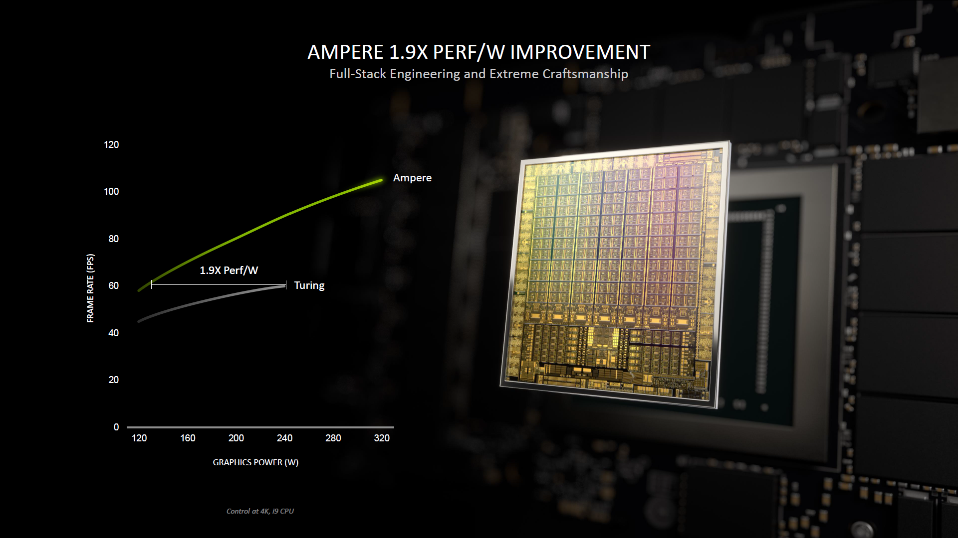

Slide 12
APPLICATIONS
8K HDR GAMING
GET CREATIVE
LOWEST LATENCY
BOSS
STREAMS
Connect,
play, capture, and watch in brilliant HDR at resolutions up to 8K with GeForce
RTX 3090
Render
complex 3D scenes,
edit 8K video, or live stream with the best encoding
and image quality
NVIDIA
Reflex delivers the ultimate competitive advantage. The lowest latency. The best
responsiveness.
NVIDIA Broadcast app takes your livestreams to the next level with powerful AI
capabilities to improve audio and video quality

Slide 13
ADVANTAGES
8K HDR GAMING
VIRTUAL REALITY
Gaming in 8K HDR resolution is available at much better FPS.
The highest performance graphics deliver the smoothest, most immersive VR experiences.
CONTENT CREATION
HIGH FPS
Whether you’re rendering complex 3D scenes, editing 8K video, or livestreaming with the best encoding and image quality.
It delivers advanced DX12 features like ray tracing and variable rate shading, bringing games to life with ultra-realistic visual effects and faster frame rates.

Slide 14
DISADVANTAGES
8K GAMING MISS
AVAILABILITY
The 8K gaming feature is very hit and miss as the technological advancement for 8K gaming have just begun.
The lack of availability in the market for consumers.
POOR VALUE
RTX 3080
The cost of production is high, hence making it not ideal for non-professional use.It serves poor value for pure gamers.
The cheaper RTX 3080 model isn’t that far behind the 3090 model.

Slide 15
Is it all perfect?
NVIDIA's Ampere product line up has been impressive all the way, there's nothing other to conclude than that. Well, performance-wise in the year 2020 we cannot complain.
Gaming
CONCLUSION
For gaming, we do not feel the 3090 makes a substantial enough difference over the RTX 3080 with 10 to 15% differentials, and that's mainly due to system bottlenecks really. You need to game at Ultra HD and beyond for this card to make a bit of sense.
A Steal
It's a purebred but unfortunately very power-hungry product that will reach only a select group of people. But it is formidable if you deliver it to the right circumstances. It is genuinely a startling product worthy of a top pick award.

